Slide 1
Blockchain Visualisation Web Application
Final Year Project 2017

Slide 2
Overview
Emulation of a blockchain network
Interactive visual experience
Demonstrate how a network is:
Initialised
Expanded
Decentralised

Slide 3
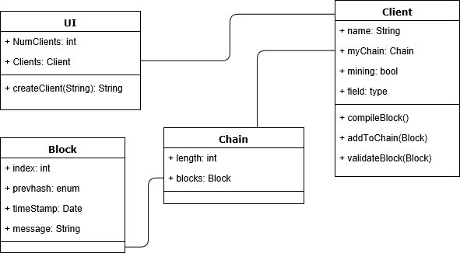
Blockchain Network
Exist across cooperating computers
Shared database
Data can be added but never removed

Slide 4
Software
Node.js
WebStorm
Heroku
MongoDB
Git

Slide 5
The App
Emulation of a blockchain
No built in transactions
Store user messages

Slide 6
Project Objectives
Visual design
User experience
Educational

Slide 7
Thank You

